Slide 1



Data-driven predictive maintenance planning for maritime industry
Problem description
Data preparation
Methodology
Results
Proposed solution

Slide 2
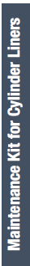
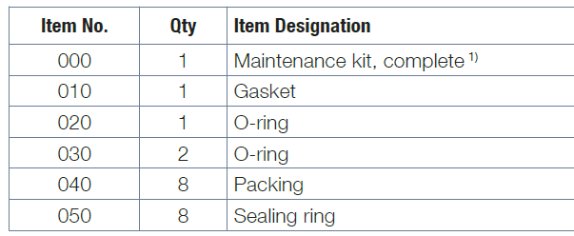
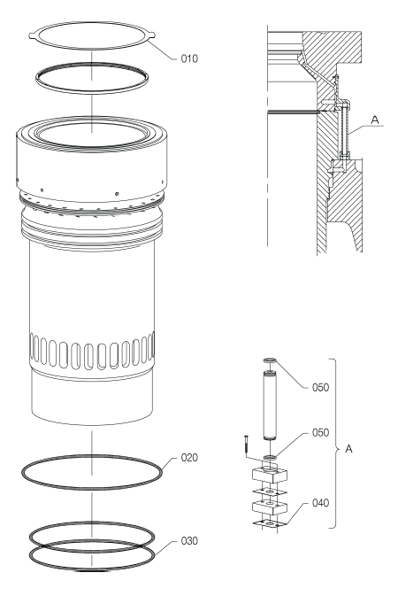
1. Problem description
Predict Spare part needs of MAN’s customers
Predict maintenance schedule
Assign maintenance type to MK available from MAN
Assign MK to corresponding spare parts
Engine Type
Maintenance Type
Maintenance Kit
Spare parts
Goal:
Ensure that spare parts that are needed for 1 year are available from MAN
Being able to show to the customers the needs they will have for the upcoming year (for each vessel)

Slide 3
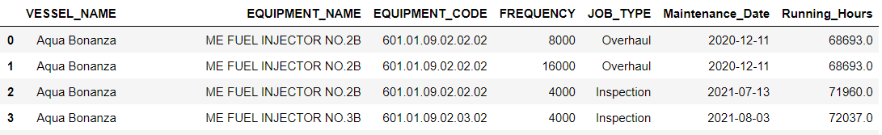
2. PMS Data
Attributes in dataset:
4 categorical:
Vessel name
Equipment name
Equipment code
Frequncy (in running hours)
Job Type
1 date:
Maintenance Date
1 continuous:
Running Hours
Equipment code broken into:
Job type
Engine number (when vessel more than one engine)
Cylinder number
601.01.09.02.02.02
Every overhaul is done every 8000 running hours or more
Job Type
Cylinder Nr.
Injector Nr. (optional)
Observations in dataset:
About 3000 rows

Slide 4
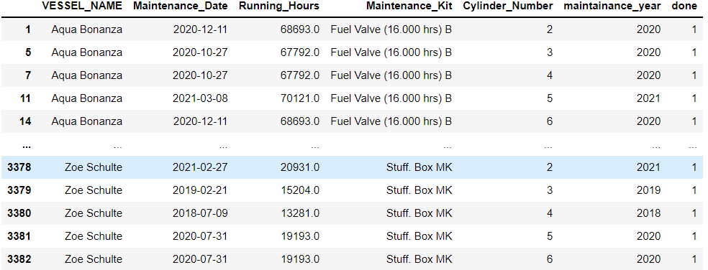
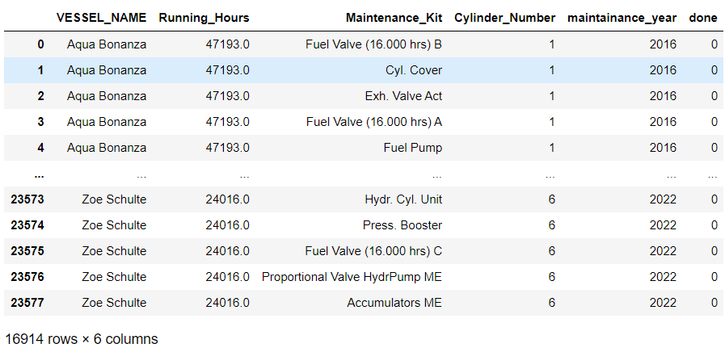
3. Data pre-processing
Pre-Process Data:
Add rows for all possible jobs that can be done in each cylinder
New observations have 0 running hours, fill them with mean of vessels current year running hours
Vessels that do not have a maintenance for the current year are filled with the mean of previous and next year
Expand data
Model output:
Binary classification
A job is done (or not) in a given year

Slide 5
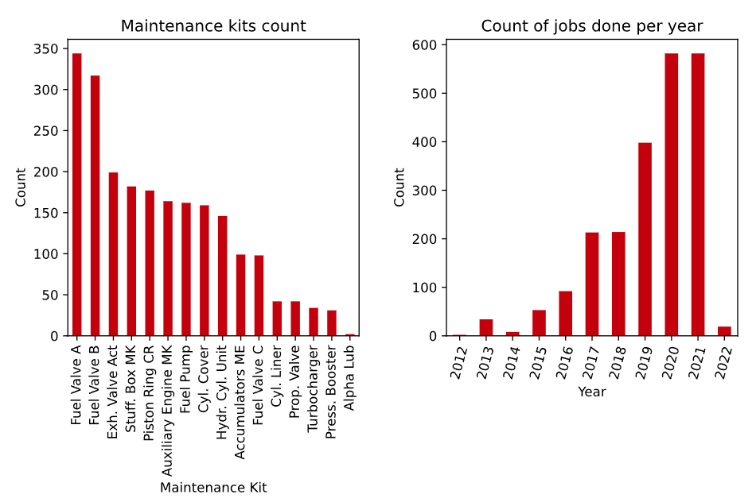
4. Data description

Slide 6
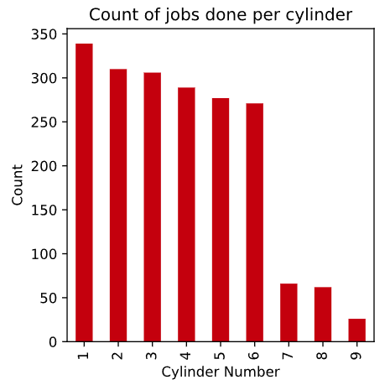
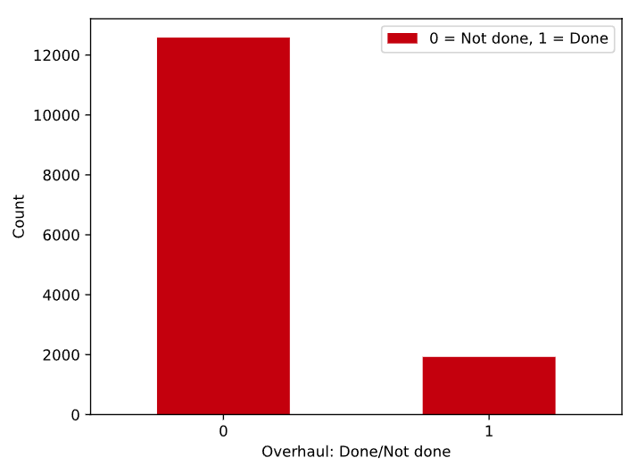
Output distribution
The variables are treated as categorical
The dataset is sparse and imbalanced
Obseration labels in the dataset
Negative: 12581
Positive: 1925

Slide 7
5. Methodology
A. Models:
Logistic Regression
Bernoulli Naïve Bayes
Random Forest
AdaBoost
Gradient Boosting
XGBoost
Artificial Neural Network
B. Evaluation methods:
(Binary classification)
Confusion Matrix
Metrics
ROC curves
Precision-Recall curves
C. Model improvement methods:
Threshold movement
Dimensionality reduction (Locally Linear Embeddings)
Class weights balancing
Hyperparameter tuning

Slide 8
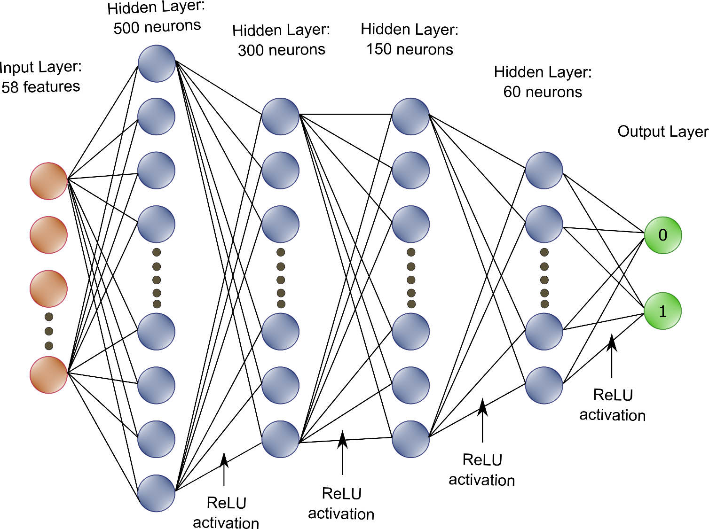
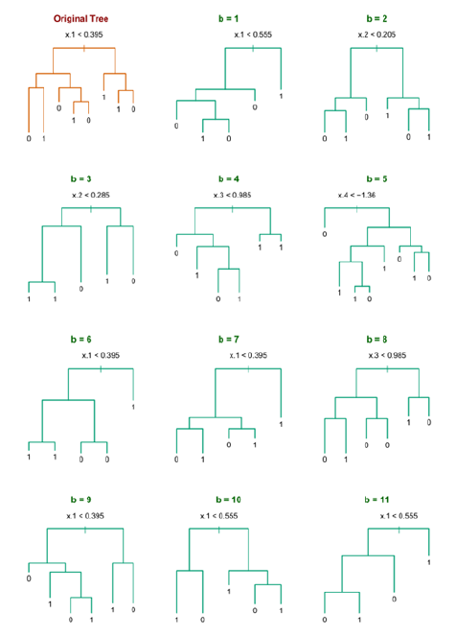
A. Models
Baseline models:
Logistic Regression
Bernoulli Naïve Bayes
Decision Trees
Ensemble
Boosting
Neural Network
Decision Tree models:
Random Forest
AdaBoost
Gradient Boosting
XGBoost
Deep Learning:
Feed-forward Artificial Neural Network
14.508 observations
Train-Test split (75% -25%)
Train on train test
Make probabilistic predictions on test set
Convert probabilities to predictions
Evaluate on test set

Slide 9
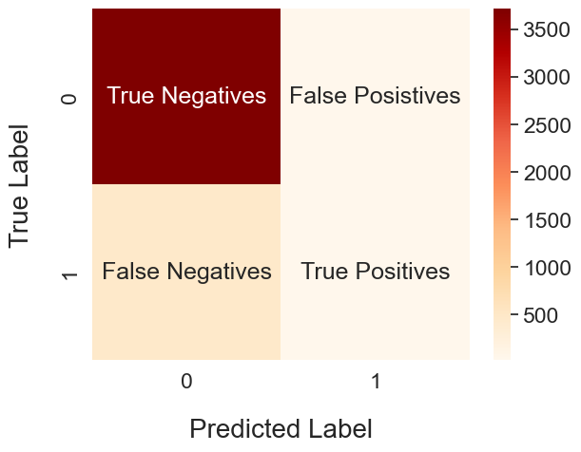
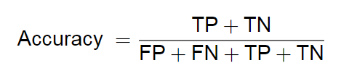
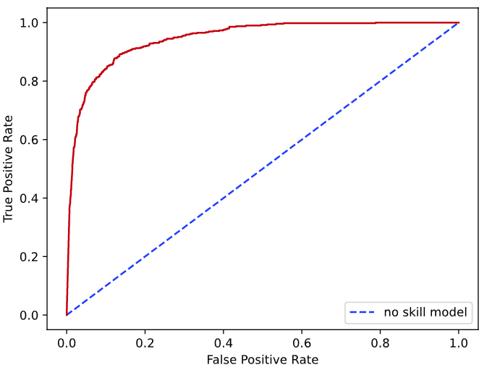
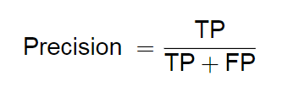
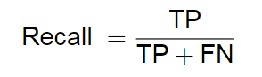
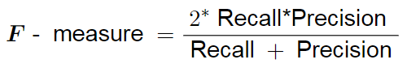
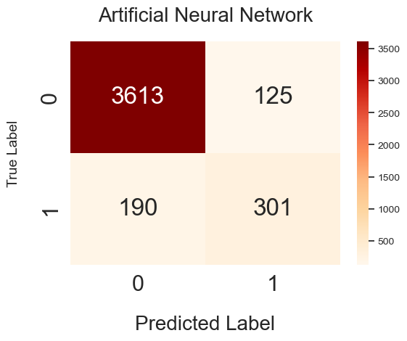
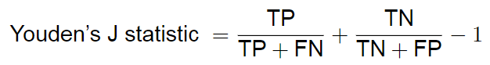
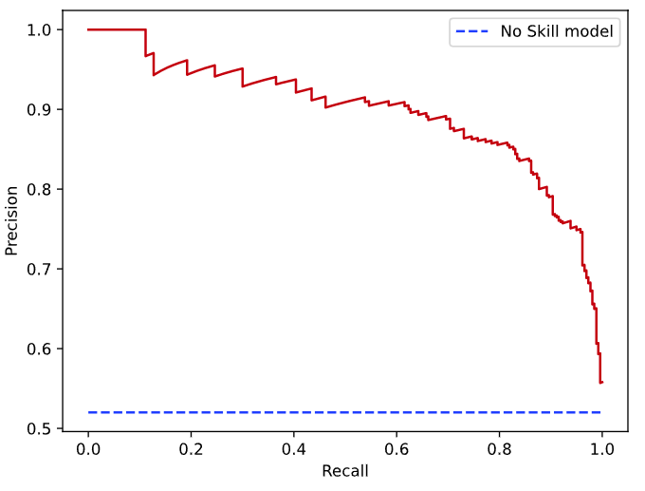
B: Evaluation methods
a) Confusion matrix
b) Metrics
c) ROC and Precision-Recall curves

Slide 10
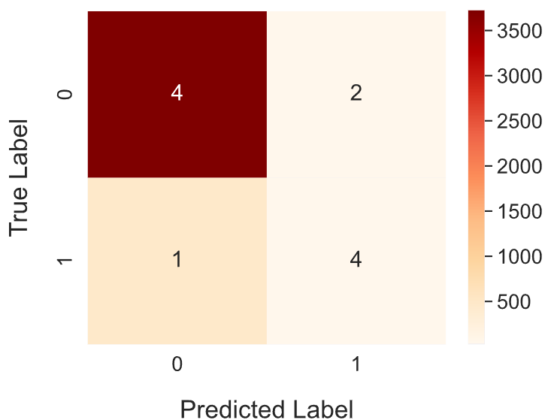
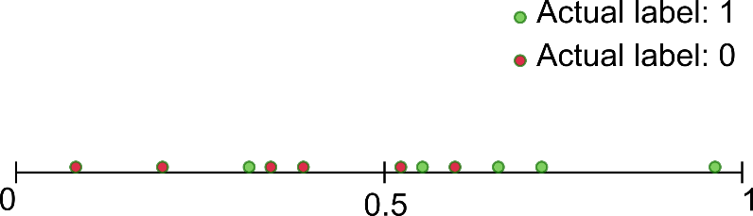

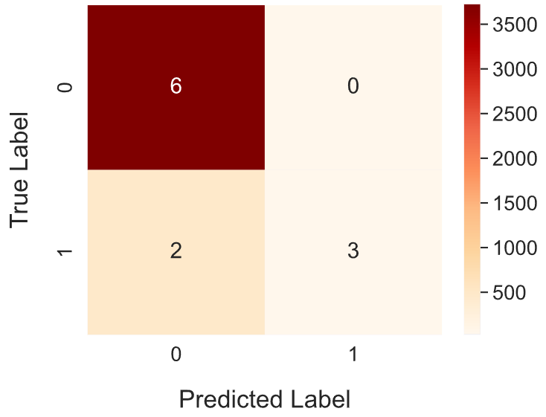
C: Model improvement methods
a) Threshold movement

Slide 11
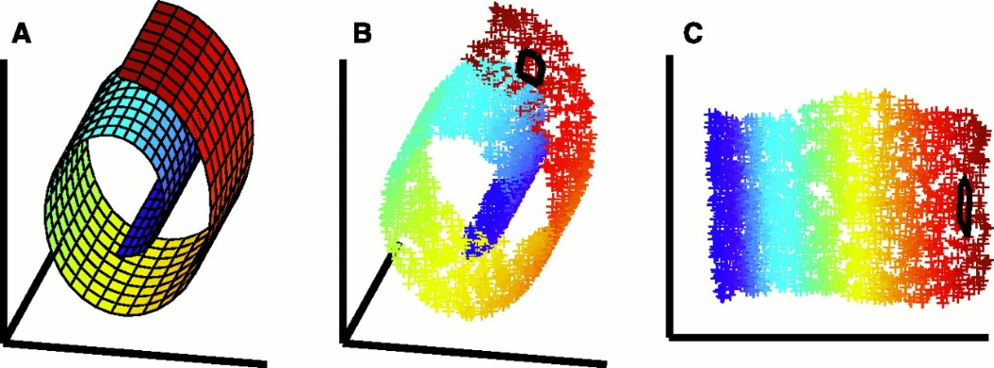
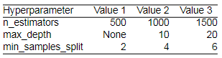
b) Dimensionality reduction
c) Class weight balancing
d) Hyperparameter tuning
Models have parameters and hyperparameters
Parameters are tuned while training the model
Hyperparameters are tuned manually, before start training
GridSearchCV can do an exhaustive search in the grid of values given
Cross-validation determines the best values for the hyperparameters
Locally Linear Embeddings (LLE)
Many categorical variables
Many features for the data
Curse of dimensionality
Reduce features
Train set contains:
11233 false labels
1452 true labels
Important to predict the true labels
Reward the model for predicting true values

Slide 12
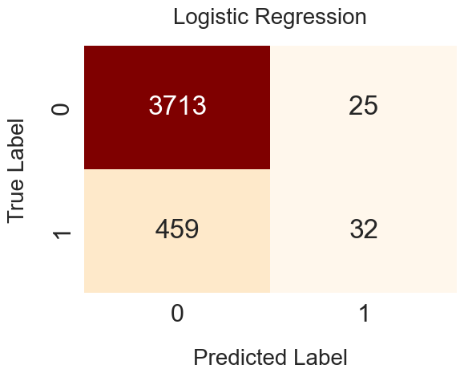
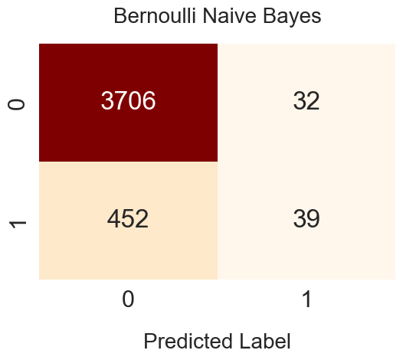
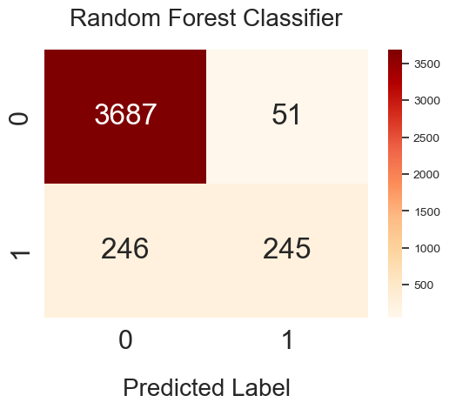
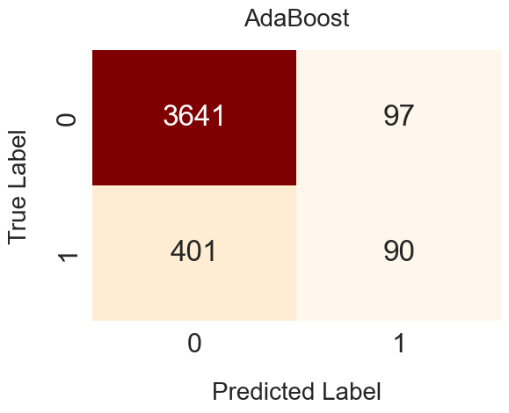
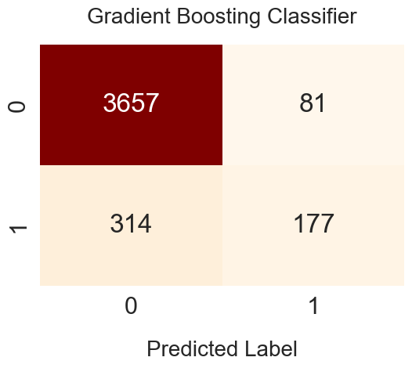
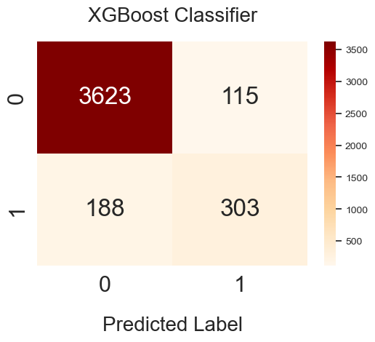
6. Initial results (Default models)
Obseration labels in the test set
Negative: 3738
Positive: 491

Slide 13
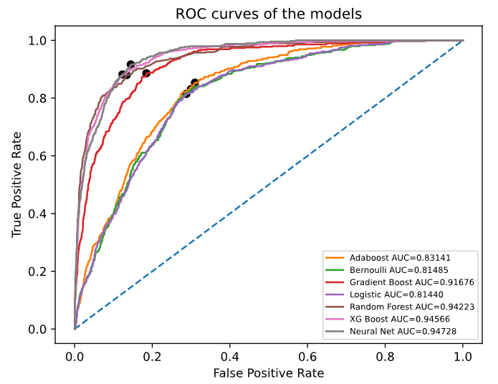
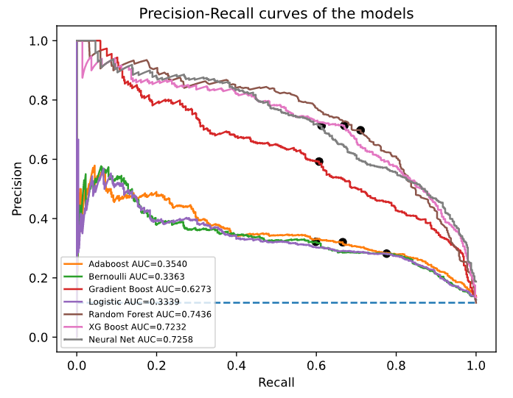
Classifier | Precision | Recall | F1 Score
Logistic Regression | 0.561 | 0.065 | 0.117
Bernoulli naïve Bayes | 0.549 | 0.079 | 0.139
Random Forest | 0.828 | 0.499 | 0.623
AdaBoost | 0.481 | 0.183 | 0.265
Gradient Boosting | 0.686 | 0.360 | 0.473
XGBoost | 0.725 | 0.617 | 0.667
Neural Network | 0.707 | 0.613 | 0.656

Slide 14
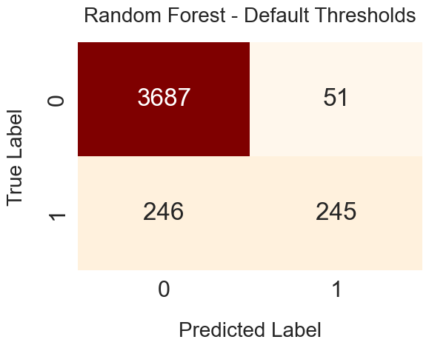
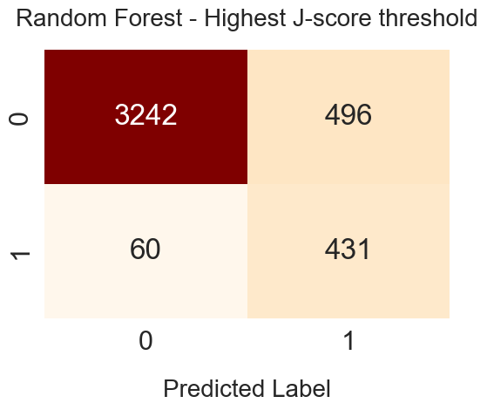
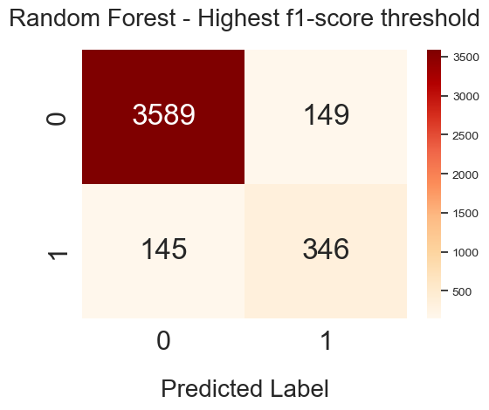
7. Threshold Movement
Random Forest
 | Default Threshold | Best J-Score | Best F1-Score
Threshold | 0.500 | 0.164 | 0.336
F1-Score | 0.623 | 0.606 | 0.704

Slide 15
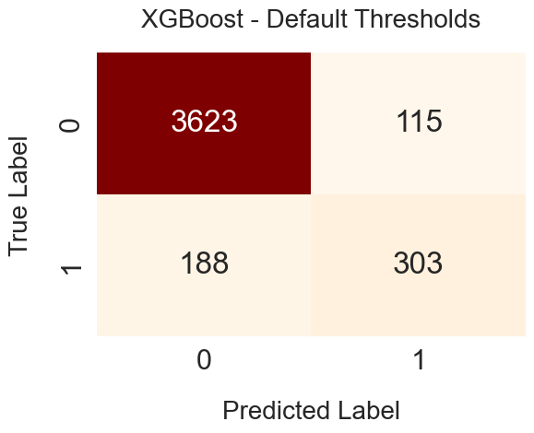
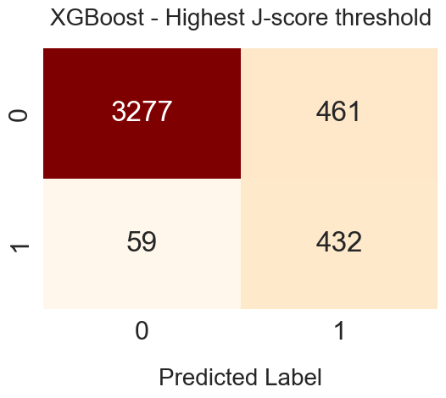
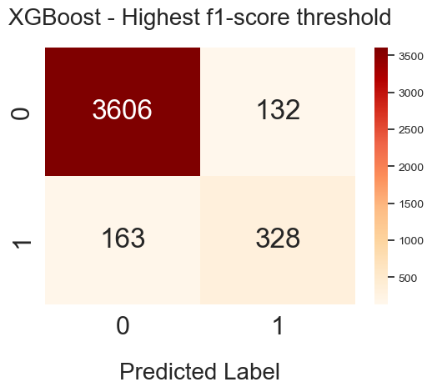
XGBoost
 | Default Threshold | Best J-Score | Best F1-Score
Threshold | 0.500 | 0.089 | 0.441
F1-Score | 0.667 | 0.625 | 0.691

Slide 16
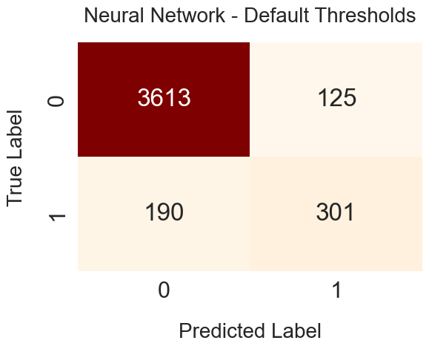


Neural Network
 | Default Threshold | Best J-Score | Best F1-Score
Threshold | 0.500 | 0.095 | 0.505
F1-Score | 0.656 | 0.607 | 0.660

Slide 17
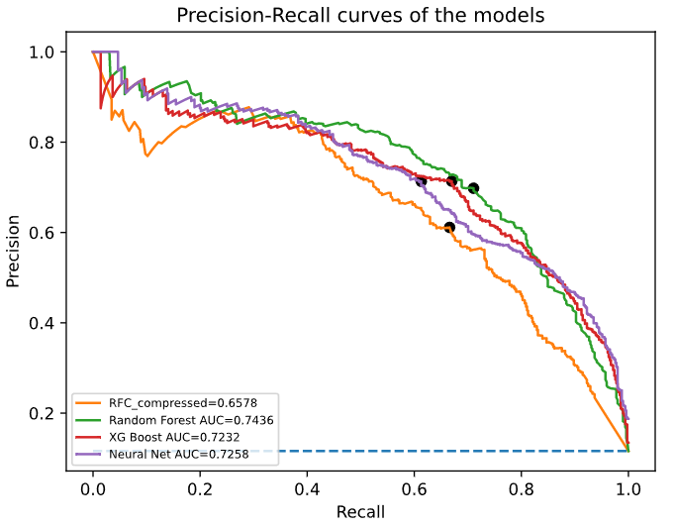
8. Dimensionality reduction (LLE)
Performed on vessel attributes (Vessel name, cylinder number)
36 features in total
Locally Linear Embeddings on 30 neighbors
36 features reduced to 4 components
Classifier | Best f1 score on initial data | Best f1 score on embedded data
Random Forest | 0.704 | 0.638
XGBoost | 0.691 | 0.487
Neural Network | 0.659 | 0.379

Slide 18
9. Class weight balancing
Train set contains:
11233 false labels
1452 true labels
Weights:
0 = 0.11
1 = 0.89
Classifier | Best f1 w/o balanced weights | Best f1 score with balanced weights
Random Forest | 0.704 | 0.716
XGBoost | 0.691 | 0.694
Neural Network | 0.660 | 0.683
Random Forest (LLE) | 0.637 | 0.638

Slide 19
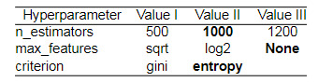
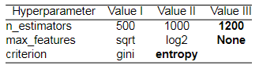
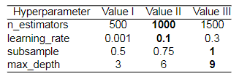
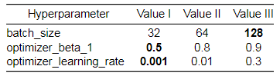
10. Hyperparameter tuning
GridSearchCV:
10-fold cross-validation in the training set
3 repeats per fold
Target: Maximize f1-score
Hyperparameter values tested for Random Forest
Hyperparameter values tested for Random Forest (LLE)
Hyperparameter values tested for XGBoost
Hyperparameter values tested for Neural Network

Slide 20
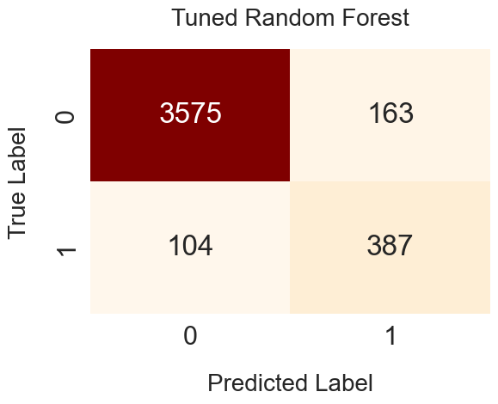
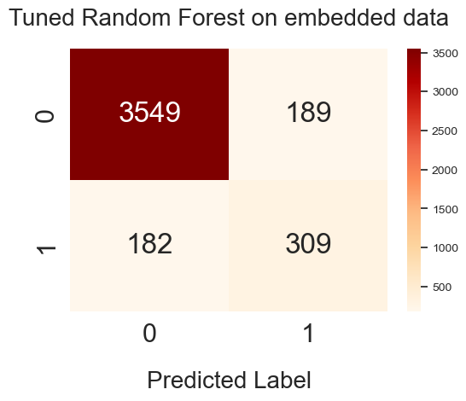
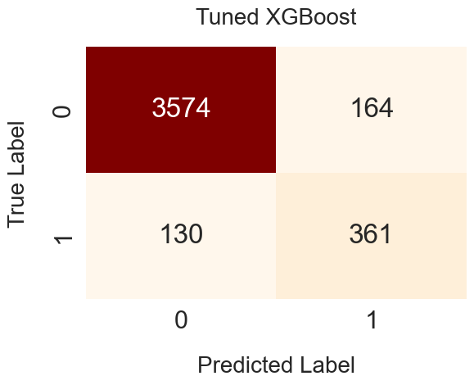
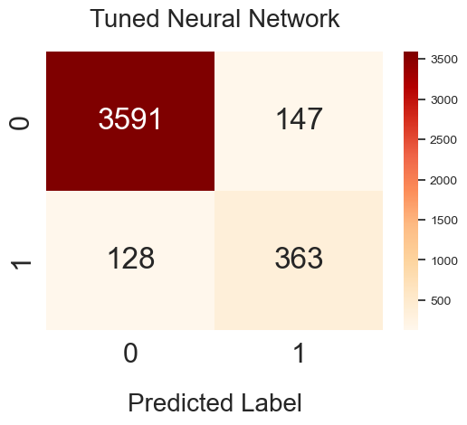

Slide 21
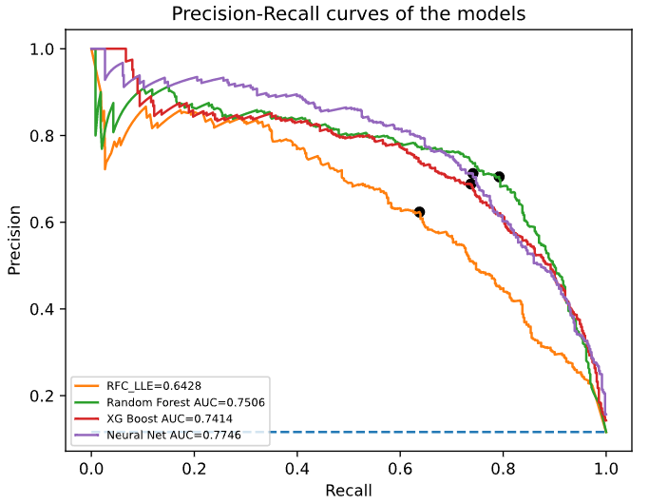
Summary of F1-Scores of the models
Classifier | Initial models | Adjusted thresholds | With balanced weights | After tuning
Random Forest | 0.623 | 0.704 | 0.716 | 0.746
XGBoost | 0.667 | 0.691 | 0.694 | 0.712
Neural Network | 0.656 | 0.659 | 0.683 | 0.727
Random Forest (LLE) | - | 0.637 | 0.638 | 0.630

Slide 22



11. Proposed model – Robustness check
Random Forest:
Best score
Simple to tune
Quick to train
Flexible (Performed well in compressed data)
Robustness check:
Predict years 2021 and 2022
Train set: Years prior to the predicted years
Test set: Years 2021/2022, correspondingly
Optimal thresholds: Cross-validation on test set
Predict year 2021
Predict year 2022
Threshold | 0.343
F1-Score | 0.154
Threshold | 0.354
F1-Score | 0.347

Slide 23

Discussion
More sophisticated models can increase quality of results
Better weight balancing techniques
More evenly distributed data is needed for more accurate predictions
Classifier | Final results | 2021 results | 2022 results
Random Forest | 0.746 | 0.154 | 0.354
XGBoost | 0.712 | - | -
Neural Network | 0.727 | - | -
Random Forest (LLE) | 0.630 | - | -

Slide 24


Conclusion
Takeaways:
Machine learning models can be used in this problem
Process that can be used for larger datasets
Binary classification models offer good explainability and better predictions

Slide 25

Any questions?

